Slide 1
Higher Education Funding Models Considerations & Lessons From Other States
WICHE Legislative Advisory Committee
Phoenix, Arizona | September 12, 2023

Slide 2
Some Recent Reform Efforts
State | Sector
Colorado | Statewide
Florida | Separate Reviews
Illinois | Four-Year Institutions
Indiana | Four-Year Institutions
Missouri | Statewide
Oregon | Separate Processes for Four- and Two-Year Institutions
Pennsylvania | PASSHE
Texas | Two-Year Institutions
Virginia | Statewide

Slide 3
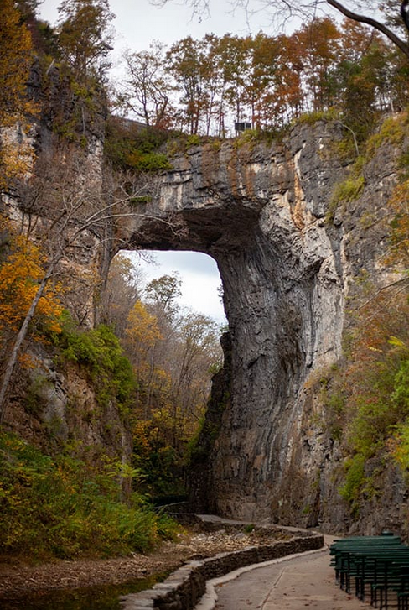
Linking Costs, State Priorities, and Funding
Preserving the value of an institution as a state asset
Recognizing variation in fixed and variable costs
Aligning state goals with a rational funding strategy that has three critical elements
Differentiated roles
Predictability & sustainability
Improvement
Serving current students effectively AND serving more and different students better
Variation in capacity to generate revenue

Slide 4
Priorities / Principles
Predictability and transparency
Capacity and responsiveness – what gets funded and how?
Performance
Adequacy first
Incentives for improvement and excellence
Unintended consequences
Funding for mission differences, local needs
Collaboration

Slide 5
Institutional Adequacy Conceptual Framework – Missouri & Virginia

Slide 6
Observations from Missouri & Virginia
Fidelity to the conceptual framework and measurement precision are difficult to balance
Defining the appropriate (aggregate) mix of tuition revenue and state appropriations to cover costs
A cost- and equity-focused funding model makes per-student funding levels inappropriate as a metric for “equitable” state support
Notes:
All of these considerations become topics of debate with the institutions

Slide 7
Adequate/Equitable Funding Depends on Who Is Served (Audiences) With What (Programs)
Institution | Total Cost Estimates | Total Funding Requirements per FTE
Exurbs | $24,518,842 | $8,606
Big City 1 | $107,680,980 | $7,320
Rural | $23,111,866 | $7,802
Deep Rural | $40,113,579 | $6,659
Rural Trades Focused | $16,949,358 | $8,567
Large Comprehensive | $98,855,129 | $8,001
Big City 2 | $112,780,246 | $6,396
Suburban | $49,719,238 | $7,057
Spread Out | $35,010,152 | $7,950
Rural Poor | $25,290,804 | $8,010
Tech First | $40,062,062 | $10,521

Slide 8
Process Questions
What are current shortcomings that need to be addressed?
What are current strengths?
Would having legislation compelling a study be valuable?
What does the modeling strategy look like?
Who is in the advisory group?
What is the broader stakeholder outreach/engagement strategy?
What gets done internally vs. outsourced?
What data are necessary? (And who has them?)
What is a realistic timeline?

