Slide 1
OPEN
EDUCATIONAL
RESOURCES (OER)
A Tool for Advancing Affordability & Student Completion
Legislative Advisory Committee Annual Meeting | 12 September 2023 | Phoenix, AZ
Presenters: Megan Crossfield, M.Ed., Yavapai College | Liliana Diaz, Ph.D., WICHE | Debbie Baker, Ed.D. & Lisa Young, Ph.D.,, Maricopa Community Colleges

Slide 2
AGENDA
01
OER LANDSCAPE
02
THE RESEARCH & EVIDENCE
03
COLLABORATION
04
POLICYMAKERS AS PARTNERS

Slide 3

Open Educational Resources (OER) are free teaching and learning resources that have been shared under a copyright license that allows for reuse, redistribution, remixing, revision, and retention in perpetuity. OER can be lesson plans, full course modules, simulations, or any resource that helps students achieve their course learning objectives.

Slide 4
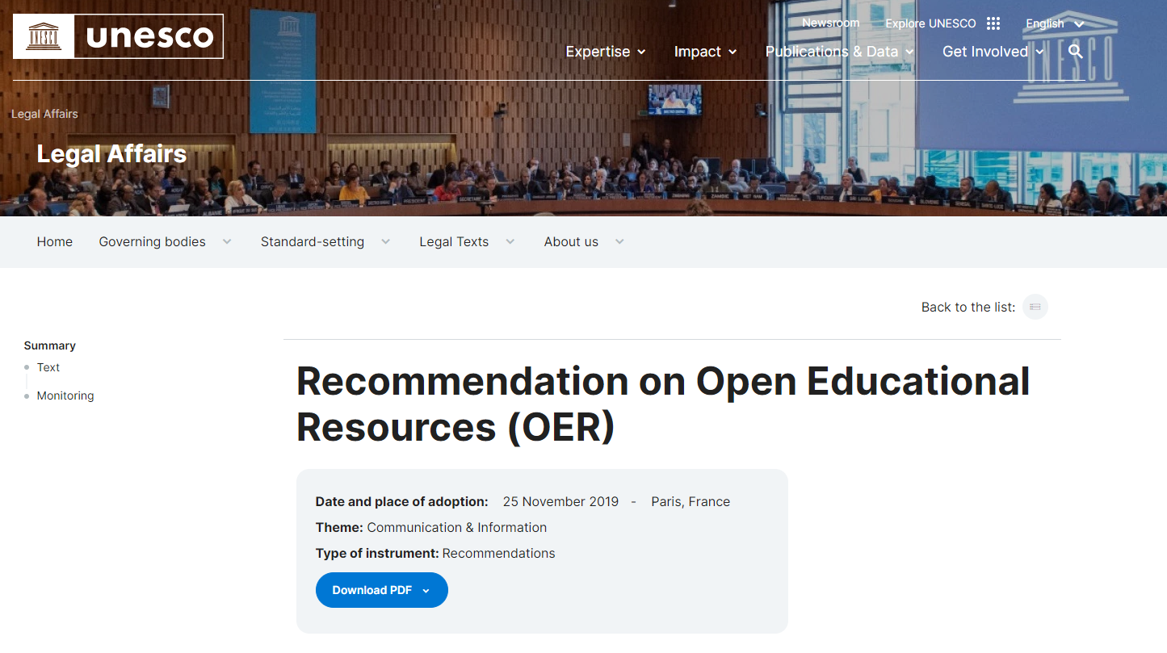
Notes:
U.S. recommitted to UNESCO in July 2023

Slide 5

INCLUSIVE/EQUITABLE ACCESS: Is it Really OER?
Inclusive Access is a textbook sales model that adds the cost of digital course content into students’ tuition and fees.
Flat-Fee Model
Under a Flat-Fee Inclusive Access model, students are charged a fixed cost based on the number of units or credit hours, regardless of the cost of their exact materials. Brand names include “First Day Complete” and “Equitable Access”.
Course-by-Course Model
Under the Course-by-Course Inclusive Access model, students participating in courses are billed for the cost of their assigned materials. Prices are set by publishers or vendors and opt-out may be available on a course-by-course basis.
Content provided by InclusiveAccess.org licensed under CC BY 4.0
Notes:
-The adoption and implementation of OER is impacting textbook sales and bookstores.
- As a response, bookstores are reframing and rebranding to entice college administrators.
- Through these models we are:
-Removing the students choice to shop around.
-Limiting access to the materials while students are registered in the class. Access is removed once the class ends.

Slide 6
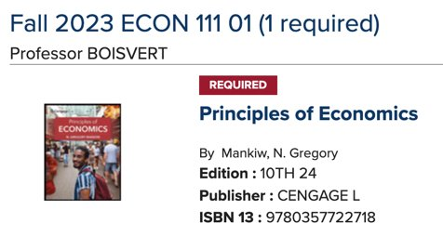



Slide 7
WHY DOES
OER MATTER?

Slide 8
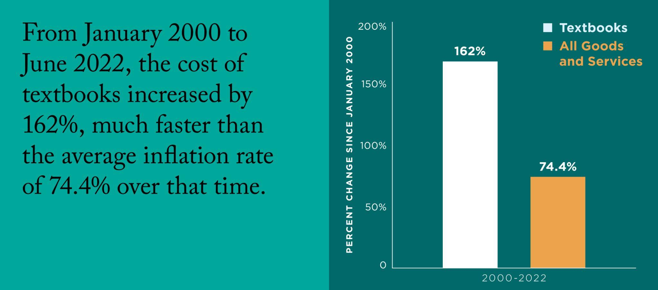
Source: Watson, C. E., & Rush-Marlowe, R. (2023). Making the case for open educational resources. American Association of Colleges and Universities (AAC&U).

Slide 9
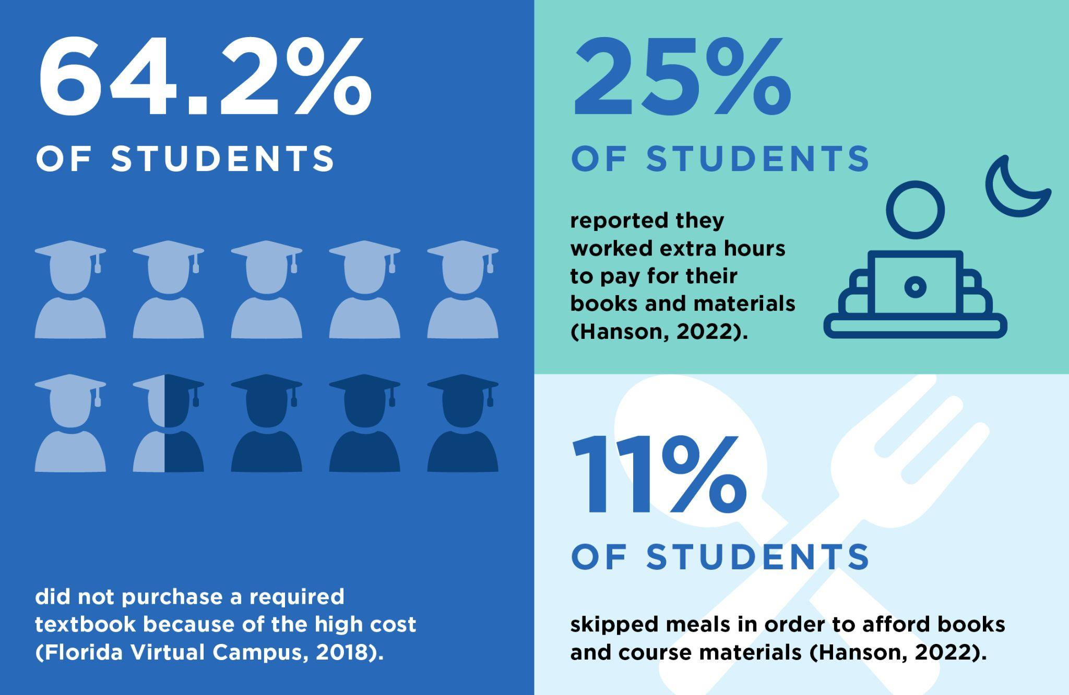
Source: Watson, C. E., & Rush-Marlowe, R. (2023). Making the case for open educational resources. American Association of Colleges and Universities (AAC&U).
Notes:
Reading the textbook is important for student success because it:
Repeated reading helps you remember information
Provides context for the topic you're studying
Provides a guide to further exploration of the topic
Some textbook material may appear in your exam, as not all material is covered during lectures
Improves your understanding of a class topic
Makes it easier for you to participate in class discussions
Helps you develop your critical thinking skills
Prepares you for the lecture by providing an understanding of the subject

Slide 10
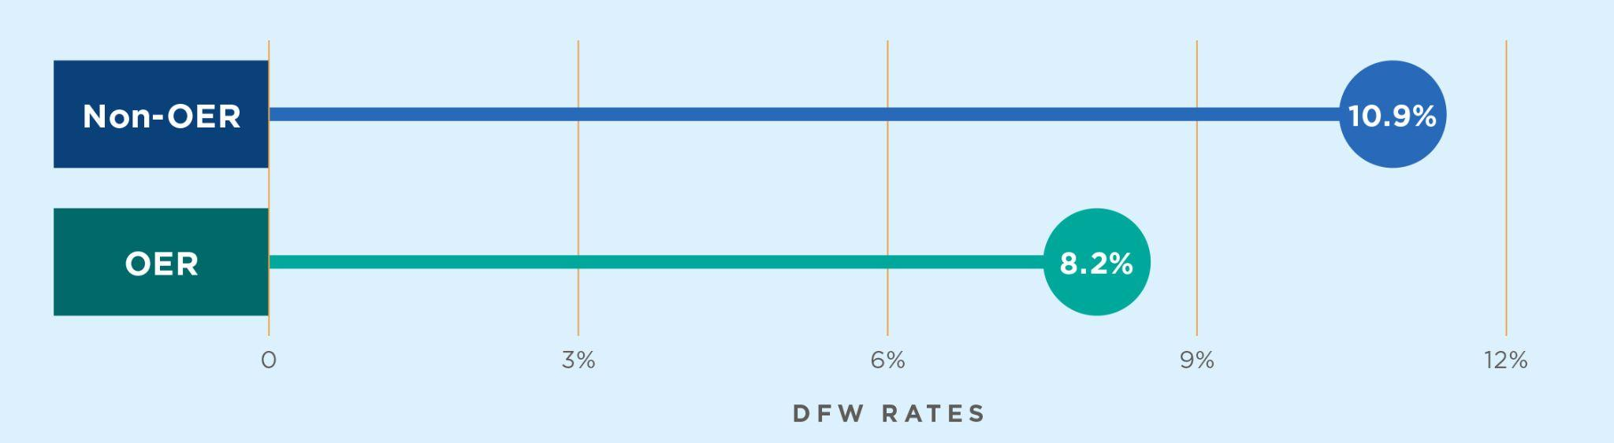
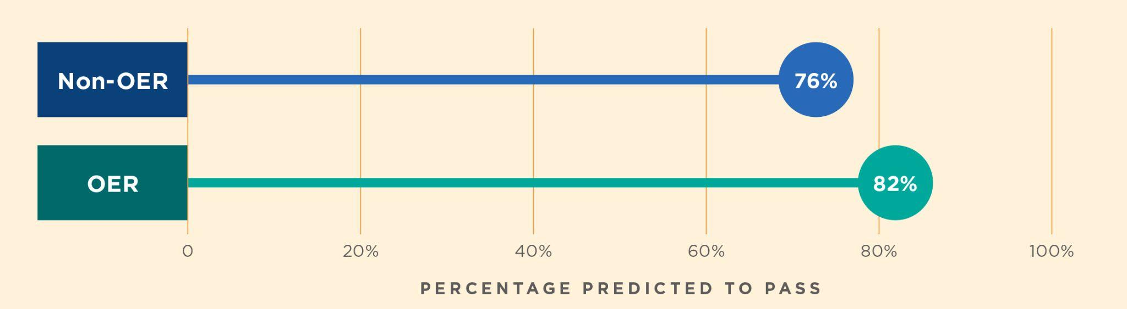
Source: Watson, C. E., & Rush-Marlowe, R. (2023). Making the case for open educational resources. American Association of Colleges and Universities (AAC&U).

Slide 11
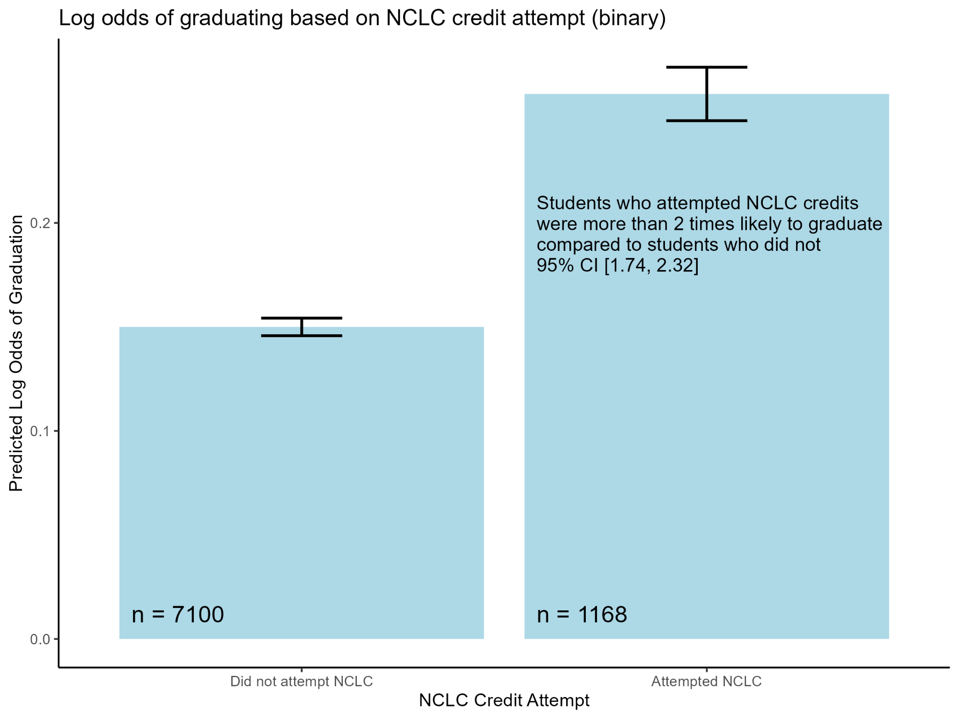
TIME-TO-COMPLETION: No-Cost/Low-Cost
Pilot study
Findings corroborate existing research
Expanding to national study on no-cost/ZTC

Slide 12
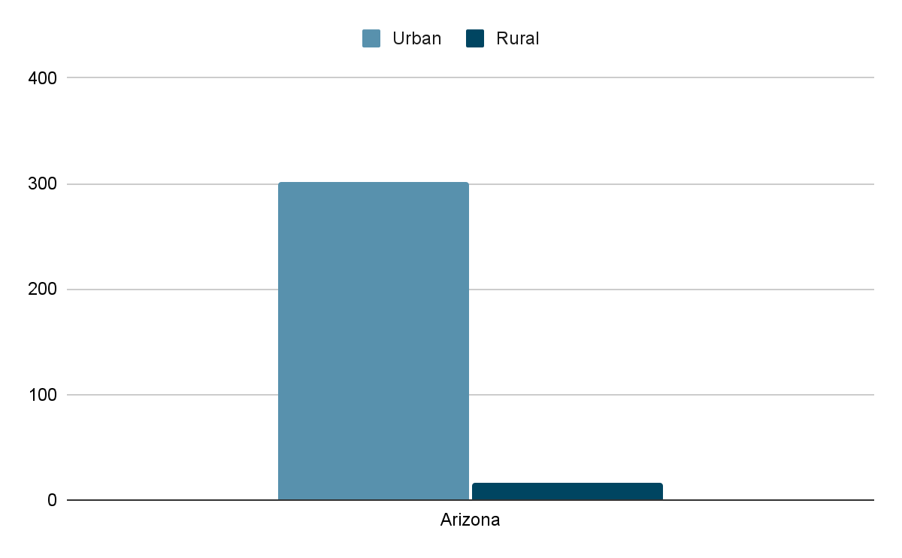
RURAL VS. URBAN DEMOGRAPHICS
Persons Per Square Mile
Educational Attainment Gap
21% of persons 25+ in rural Arizona have a bachelor’s degree or higher compared to 33% in urban Arizona.
Persons in Poverty
15% of people in rural Arizona live in poverty compared to 12% in urban Arizona.
United States Census Bureau. (2020). Quick Facts. Retrieved from https://www.census.gov/quickfacts/fact/table/US/POP010220.
Notes:
-Arizona is 83% geographically rural
-Serving students in rural communities takes a different approach.
-Within Phoenix there are similar data points that represent educational attainment gaps and persons in poverty if broken out by zip codes.

Slide 13
OER IMPACTING RURAL COMMUNITIES
Yavapai College as a Case Study - Fall 2020 through Fall 2023
Improving Access to Course Learning Materials
151 faculty completed YC’s OER training.
111 courses have been built using OER and have been openly licensed.
21% of sections offered fall 2023 are OER.
Dual Credit Usage of OER
Increasing OER Course Enrollment & Student Cost Savings
18,449 students enrolled in OER courses.
$2,029,390 saved in textbook and course material fees.
Boosting Next Semester Credits
Students taking in 2 or more OER courses enrolled in 2.5 more credits the next semester compared to students taking in 2 or more non-OER courses.
Understanding Student Perceptions about OER: 3,583 students completed the survey.
50% responded YES, they have purchased a textbook and did not use it.
59% agree with the statement “purchasing textbooks is financially difficult for me”.
86% agreed that the course was organized and easy to follow.
Notes:
Population of Yavapai County 242,253
Unduplicated students 8,393

Slide 14
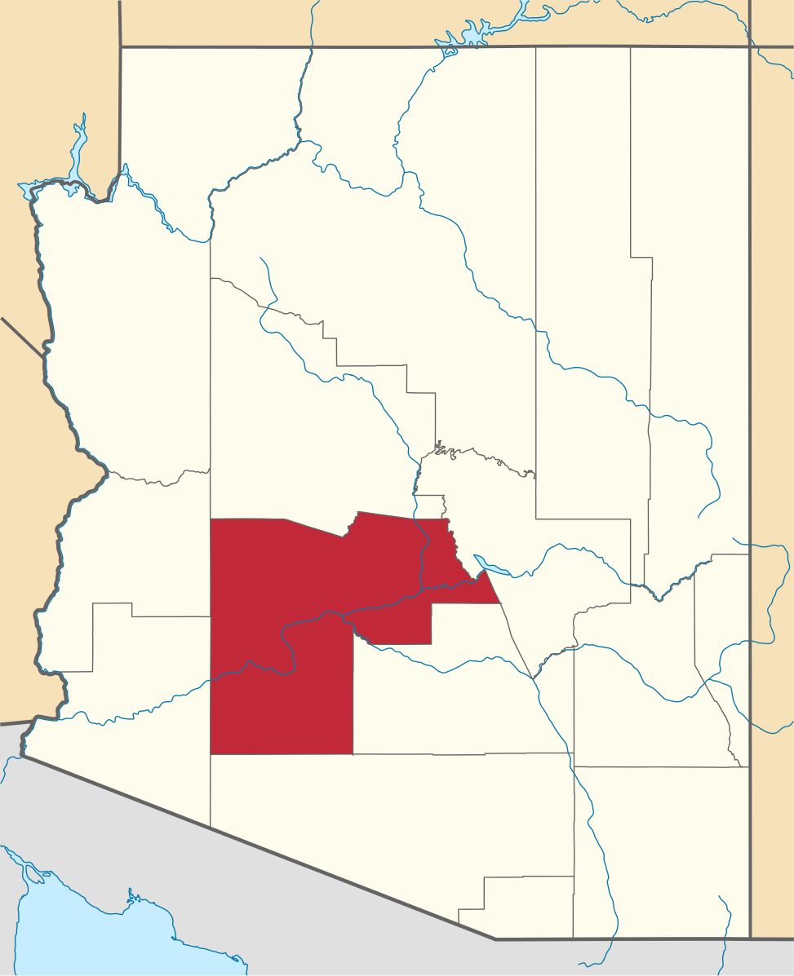
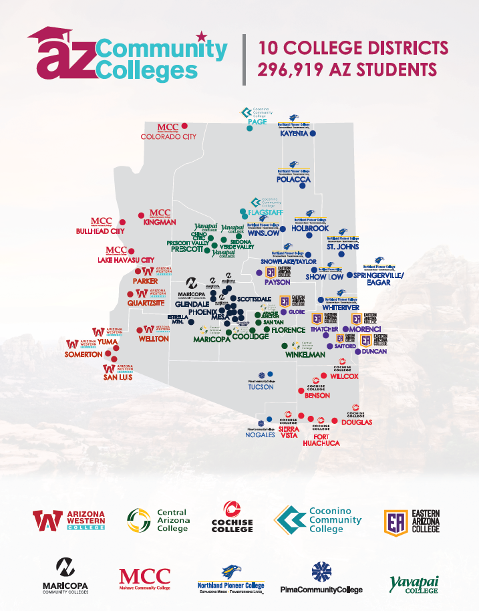

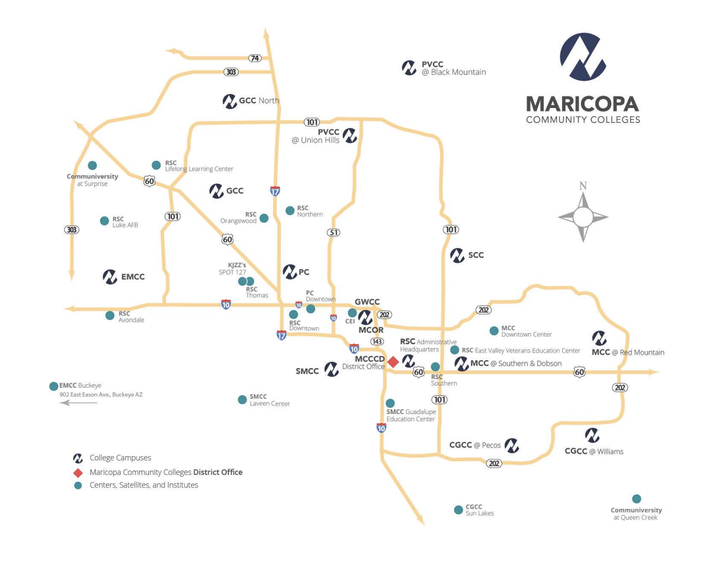
Arizona Community College Coordinating Council

Slide 15


2022-2023 Fast Facts
83,301 student enrollment Spring 2023
90% Maricopa County Resident
88 academic programs
585 occupational programs certificate programs
6,648 transfer degrees awarded 2021-2022
6,472 transfer certificates awarded 2021-2022
10,815 occupational awards 2021-2022
16% No cost/Low cost adoption

Slide 16
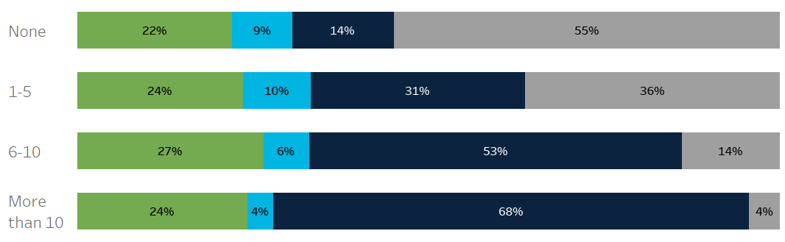

OER IMPACTING URBAN COMMUNITIES
Maricopa Community Colleges - Case Study - Fall 2023
Improving Access to Course Learning Materials
3,658 courses have been built using low cost or no cost materials.
25% of sections offered fall 2023 are No cost/Low cost.
Increasing OER Course Enrollment & Student Cost Savings Fall 23
67,510 students enrolled in OER courses.
Up to $7,316,000 saved in textbook and course material fees.
Boosting Completion
Students enrolled in multiple low cost/no cost courses are less likely to drop out.
Completion No Cost/Low Cost Programs - 2016-17 Cohort

Slide 17
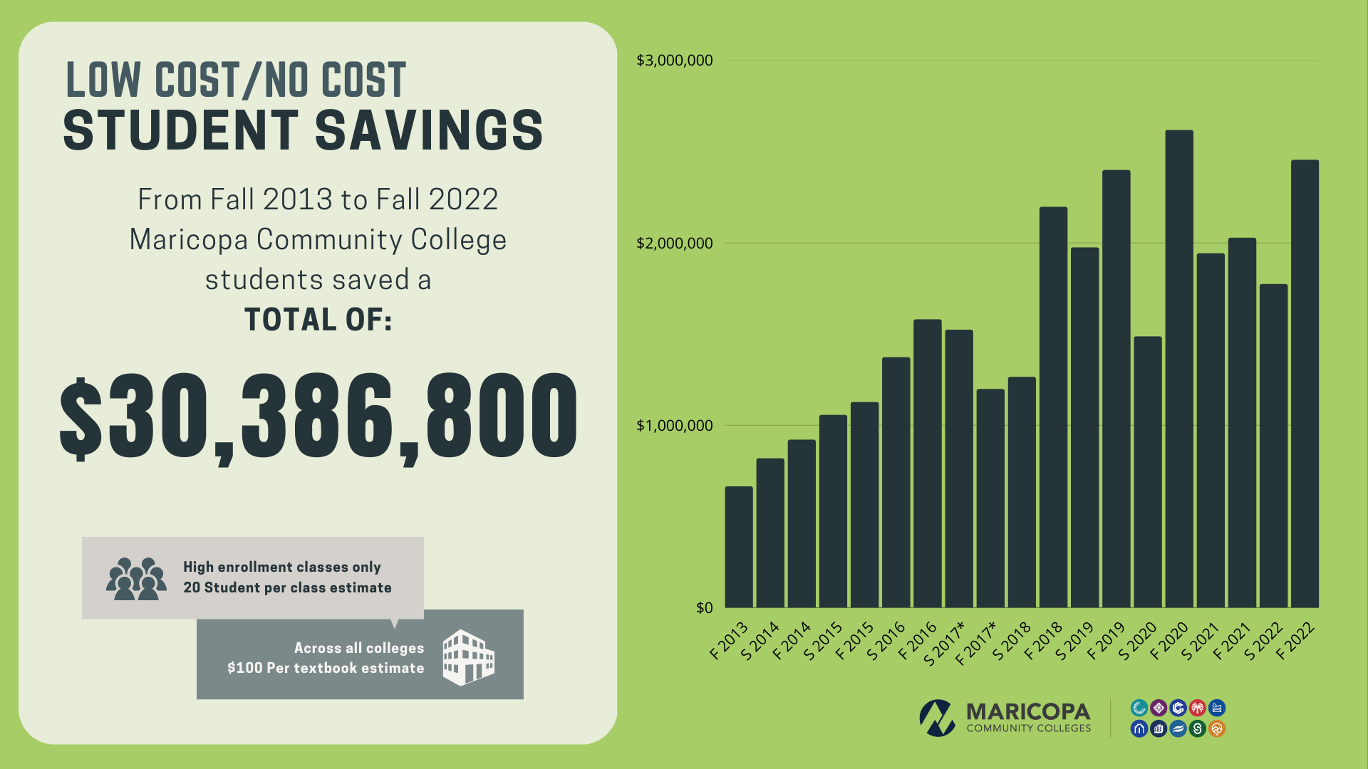

Slide 18
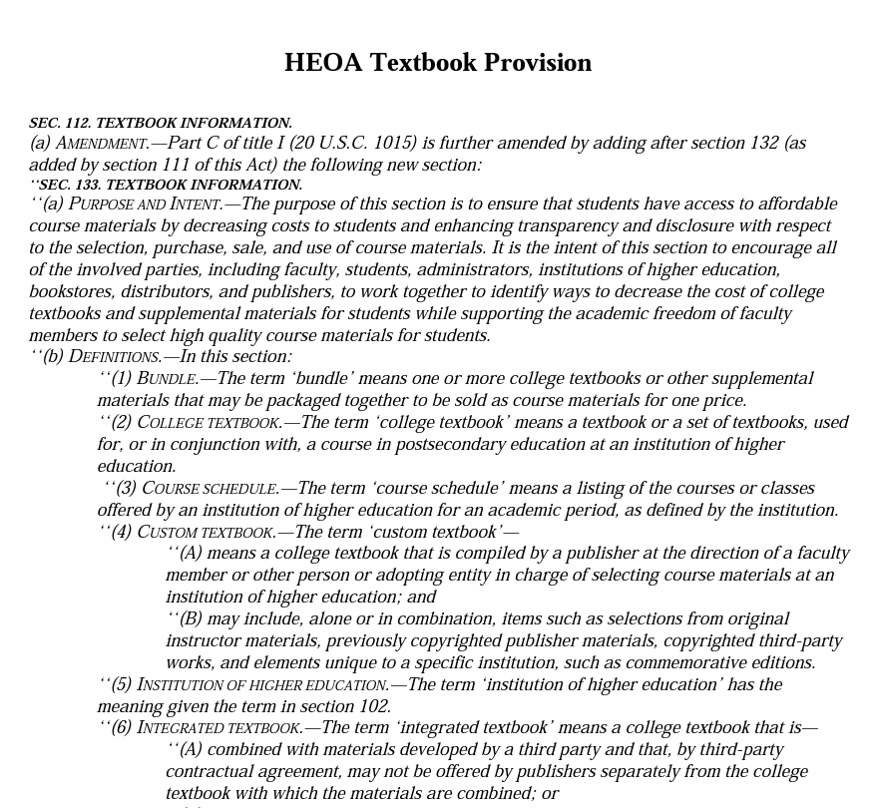
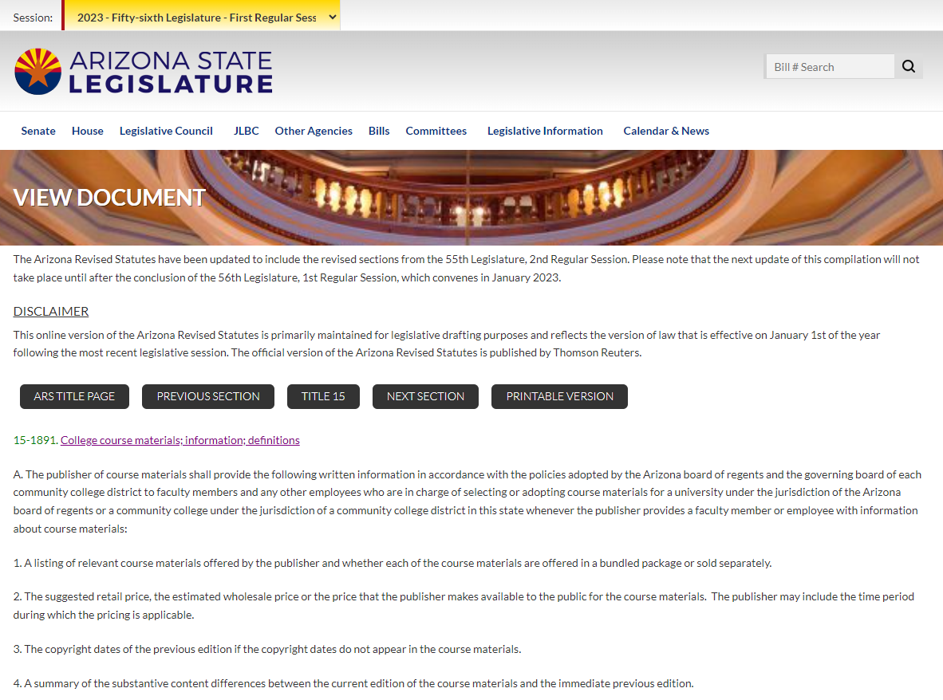
FEDERAL & STATE GUIDELINES
Notes:
YC is using these two policies to encourage the use of OER to meet compliance on textbook and material transparency.
If we have a course with no instructor assigned but has an approved OER master build, the course is coded as OER. Once an instructor is assigned, the OER shell will be used.
This way students are aware of the cost when registering for the class.

Slide 19
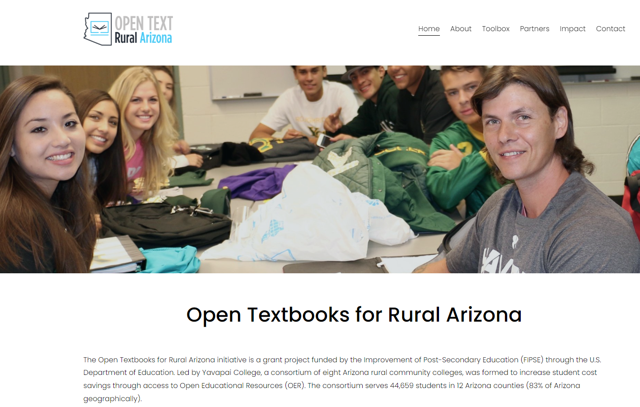
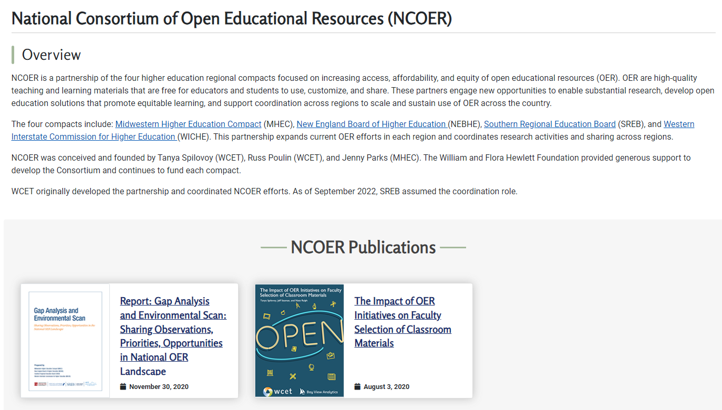

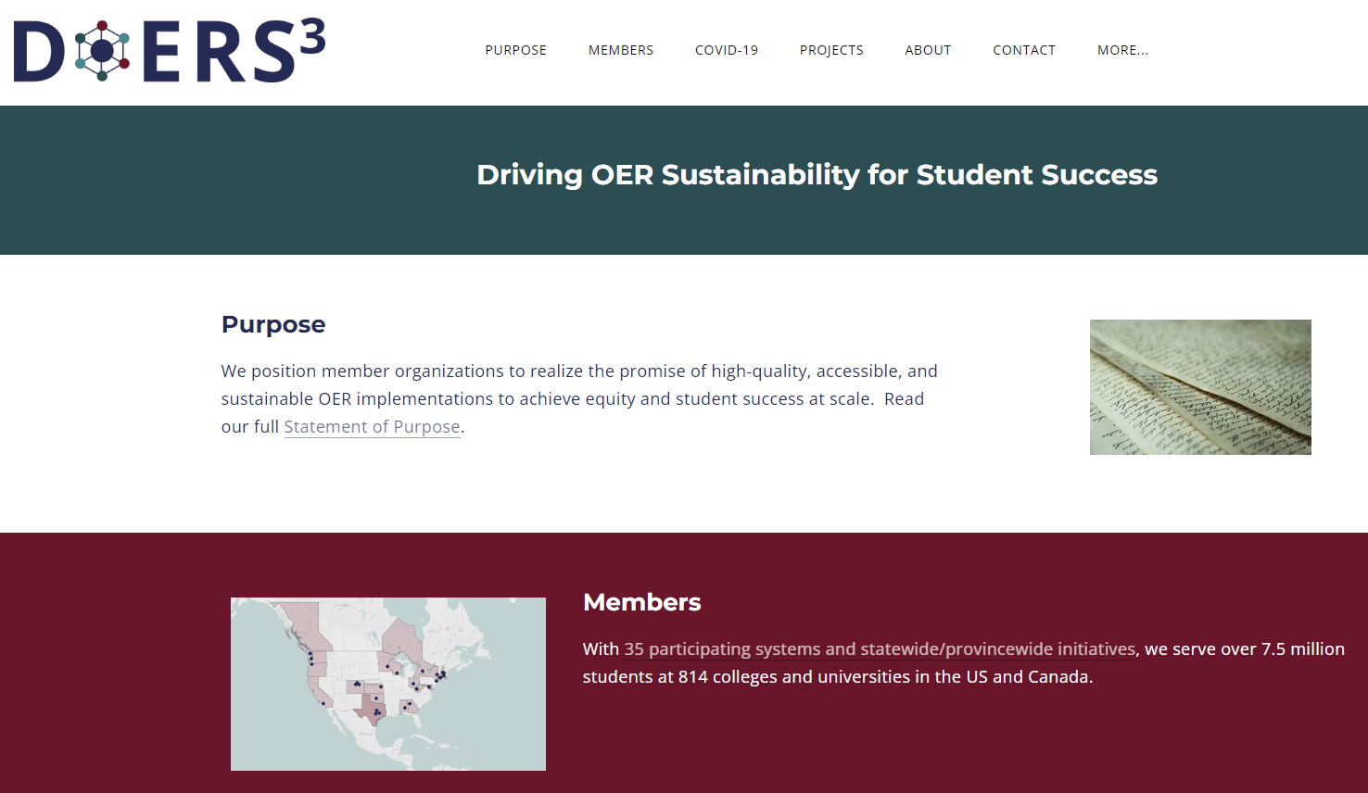
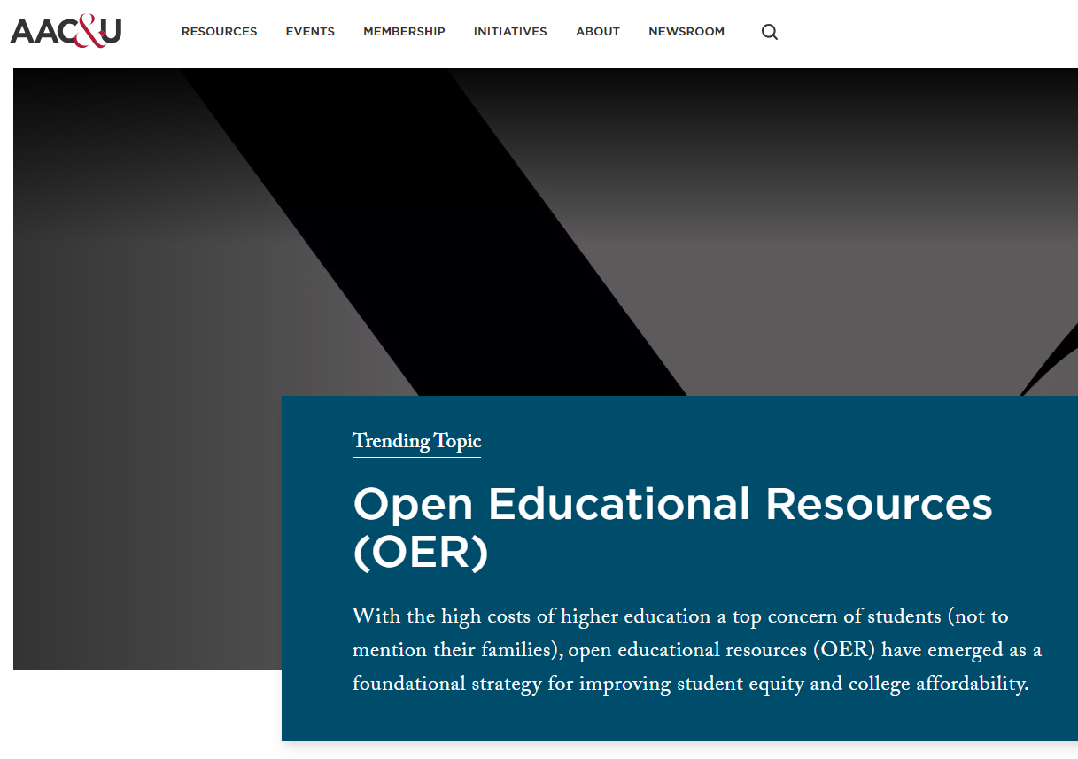
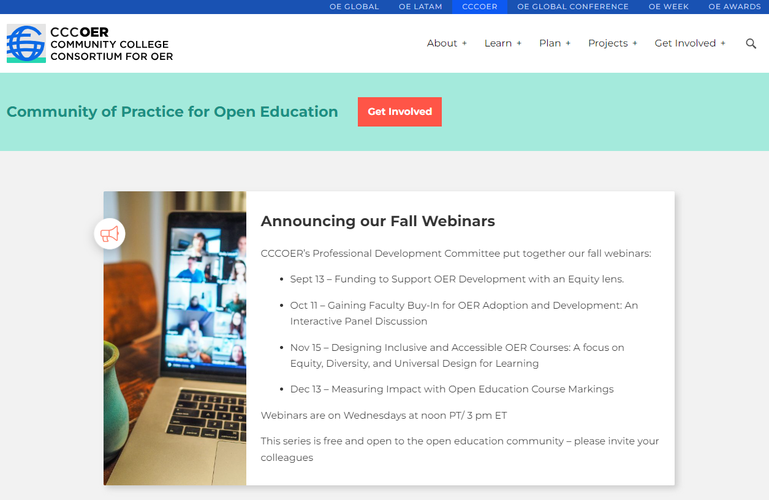
INTERSTATE & INTRASTATE COLLABORATION

Slide 20

PARTNERING WITH HIGHER EDUCATION
IN YOUR STATE
Require materials created through state and federal grants to be openly licensed
Support statewide course marking efforts
Protect Zero-Textbook Cost offerings from fees
Provide funding for statewide collaboration efforts
Support consistent reporting at the national level

Slide 21

RESPONSIVENESS OF OER
Meeting concurrent/dual enrollment student needs
OER materials for teacher prep and nursing
Representation of local communities and their histories
Industry demand and contextualization

Slide 22
CONTACT US!
Debbie Baker, Ed.D. OER Coordinator & Instructional Designer
Maricopa Community Colleges
deborah.baker@domail.maricopa.edu
Liliana Diaz, Ph.D. Senior Policy Analyst
WICHE
ldiaz@wiche.edu
Megan Crossfield, M.Ed. Manager
Academic Initiatives & Special Projects
Yavapai College
megan.crossfield@yc.edu
Lisa Young, Ph.D. Faculty Administrator | Open Education Programs and Innovation
Maricopa Community Colleges
lisa.young@domail.maricopa.edu

Slide 23
QUESTIONS?

Slide 24
INCLUSIVE ACCESS: Myths vs. Facts
Savings or Spin? Inclusive Access content may appear discounted, by not always by much, and prices can rise.
Convenient or Confined? Inclusive Access can provide first-day access to content, but it constraints students’ choices as consumers.
Opt-Out or Drop-Out? Students can opt out of Inclusive Access, but doing so can block them from required coursework.
Inclusive or Exclusive? No matter what price of Inclusive Access content it, it is still unaffordable for some students.
Retain or Just Rent? Students never own Inclusive Access content - they usually rent it, sometimes for a higher price than a print rental.
Supported or Stymied? Inclusive Access can limit faculty’s freedom to choose materials that meet their students’ needs.
Solution or Status Quo? Peer-reviewed research found that Inclusive Access did not improve academic outcomes.
Content provided by InclusiveAccess.org licensed under CC BY 4.0

